Slide 1
Anonymous inner class
A class that have no name is known as anonymous inner class in java. It should be used if you have to override method of class (may be abstract or concrete) or interface.

Slide 2
Anonymous inner class
Person personRef= new Person()
{
void walk()
{
System.out.println("Walking fast");
}
};
A class is created but its name is decided by the compiler which implements the Person interface and provides the implementation of the walk() method..
An object of Anonymous class is created that is referred by “personRef” reference variable of Person type.

Slide 3
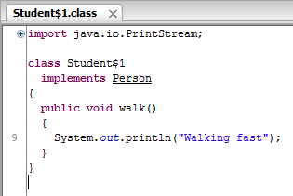
Anonymous inner class

